Slide 1
Uk Trains Dataset Analysis
Group 5

Slide 2
Under Supervision Of:
Presented By:
Eng/Osama Adel
Toqa Mohamed Ahmed Mahfouz Leader
Abdelrahman Medhat Farouk Member
Razane Abdelkarim Mohamed Member
Roaa Ahmed Muhammad Member

Slide 3

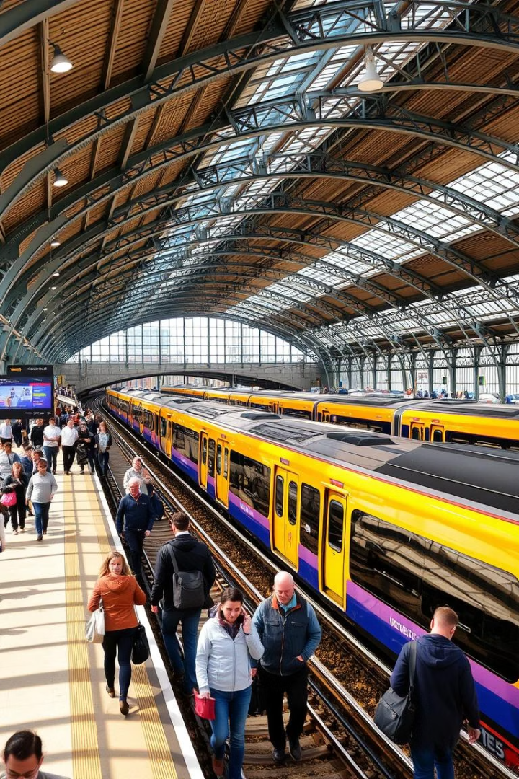
What is Uk train analytics?
This project aims to analyze train ticket purchase and journey data across the UK to gain valuable insights into customer behaviors, ticketing trends, travel patterns, and operational performance. The dataset captures a wide range of attributes, from transaction details and pricing to journey durations and delay reasons, offering a comprehensive view of the UK train travel experience.

Slide 4
UK Train dataset is a system where you store and manage data on Uk Train data can be used to track a variety of information, including UK Train , which giveinsights for better decision-making.
It may include:
transaction_id,date_of_purchase,purchase_type,,payment_method,railcard,ticket_class,ticket_type, price ,price_range, routes, departure_station, date_of_journey, departure_time ,arrival_time ,actual_arrival_time ,duration_total_hours
duration_total_minutes ,expected_arrival_time ,category_of_journey ,journey_status , reason_for_delay ,refund_request

Slide 5
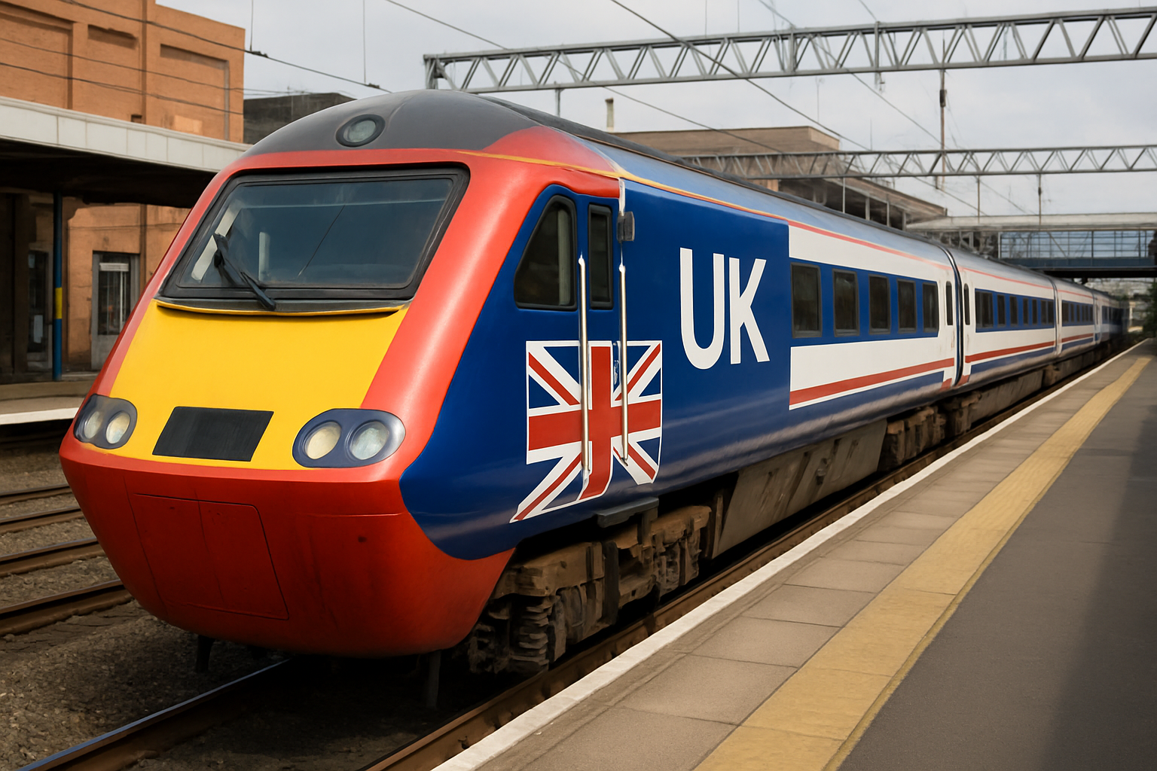
Project Objective:
Perform in-depth analysis of train ride performance, usage patterns, and revenue trends.
Understand customer preferences regarding ticket types, travel patterns, and usage behavior.
Forecast the number of rides and expected revenue for each day of the upcoming month.
Identify reasons for delays and calculate average delay duration per rail line.
Supporting business decisions to improve efficiency, customer satisfaction, and operational performance.

Slide 6
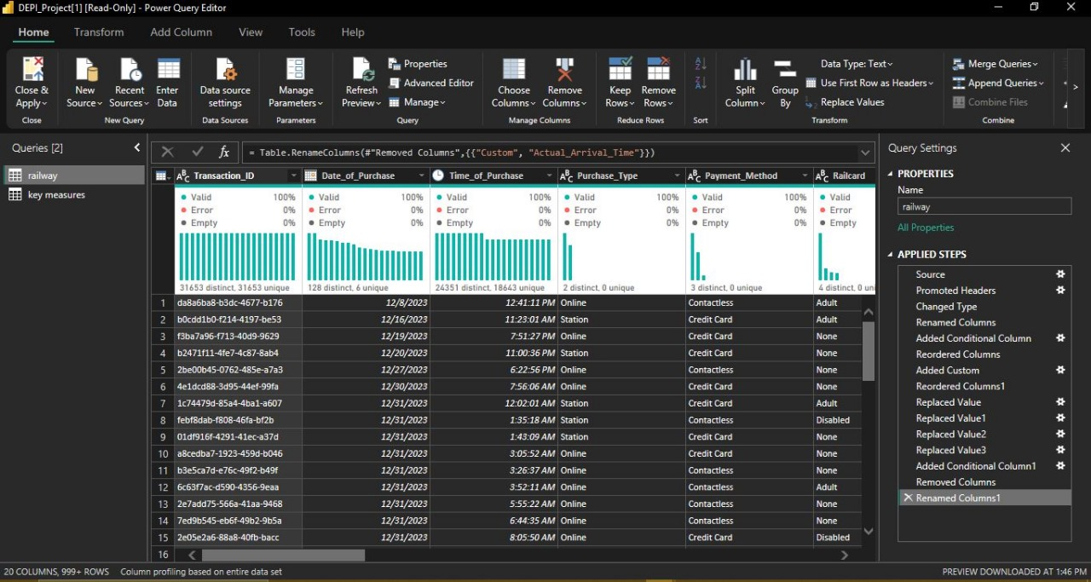
UK Dataset:
Train Table

Slide 7
Analyzing the Data:

Slide 8
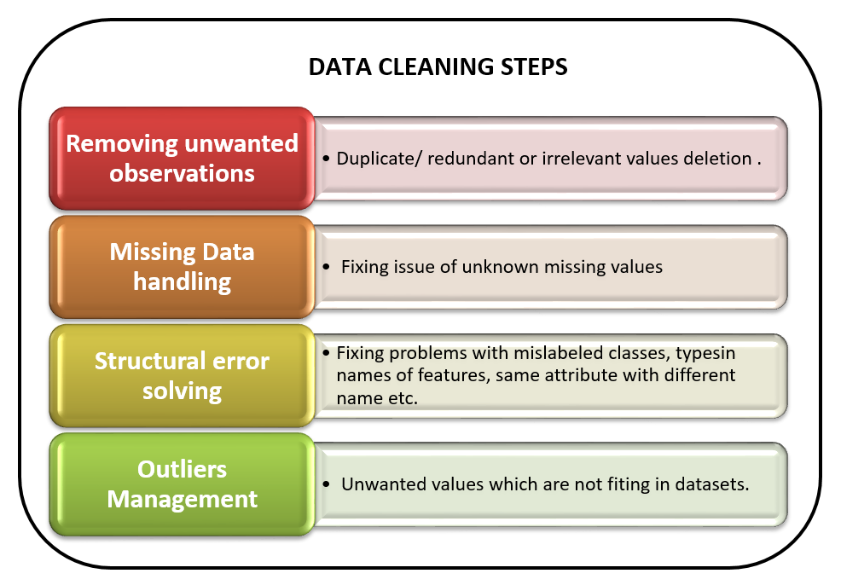
Data Cleaning

Slide 9
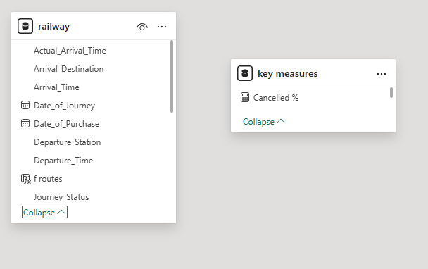
Data Modeling
Data modelling is the process of creating a diagram that represents your data system and defines the structure, attributes, and relationships of your data entities.
Data modelling organizes and simplifies data in a way that makes it easy to understand, manage, and query, while also ensuring data integrity and consistency. Data models inform about data architecture, database design, and restructuring legacy systems.

Slide 10
Analyzing & Insights
High Usage of Discounted Tickets: A significant portion of passengers utilize railcards and discounted ticket types such as Advance and Off-peak, indicating strong price sensitivity among travelers.
Online Purchases Dominate: Most tickets were purchased online, suggesting a trend toward digital channels and a reduced reliance on station ticket counters.
Standard Class Is the Preferred Option: The majority of travelers opted for standard class over first class, likely due to affordability and the effectiveness of discounts.
Most Journeys Are Short to Medium in Duration: Based on the custom duration column, a large number of trips fall under the short and medium categories (under 60 minutes), highlighting a focus on commuter and regional travel.
Delays Are Common but Often Minor: While delays occurred across various routes, most were under 15 minutes, with "No Delay" still being the most frequent status. Common reasons for delays included signal failures, weather disruptions, and train congestion.

Slide 11
Analyzing & Insights
Refund Requests Are Closely Tied to Longer Delays: Refunds were mainly requested for trips delayed over 30 minutes, especially on peak routes, showing a clear relationship between delay severity and customer dissatisfaction.
Ticket Price Range Trends: Most ticket prices fell into the medium range (£50–£150), with high-priced tickets often associated with first-class and Anytime purchases, and low-priced tickets linked to Advance or Off-peak fares with railcard discounts.
Peak Times Are Less Popular for Discounted Tickets: Off-peak tickets were more frequently used outside of rush hours (6–8 AM and 4–6 PM), confirming proper policy enforcement and usage patterns.

Slide 12

Determining Answers of Questions From Visualization

Slide 13
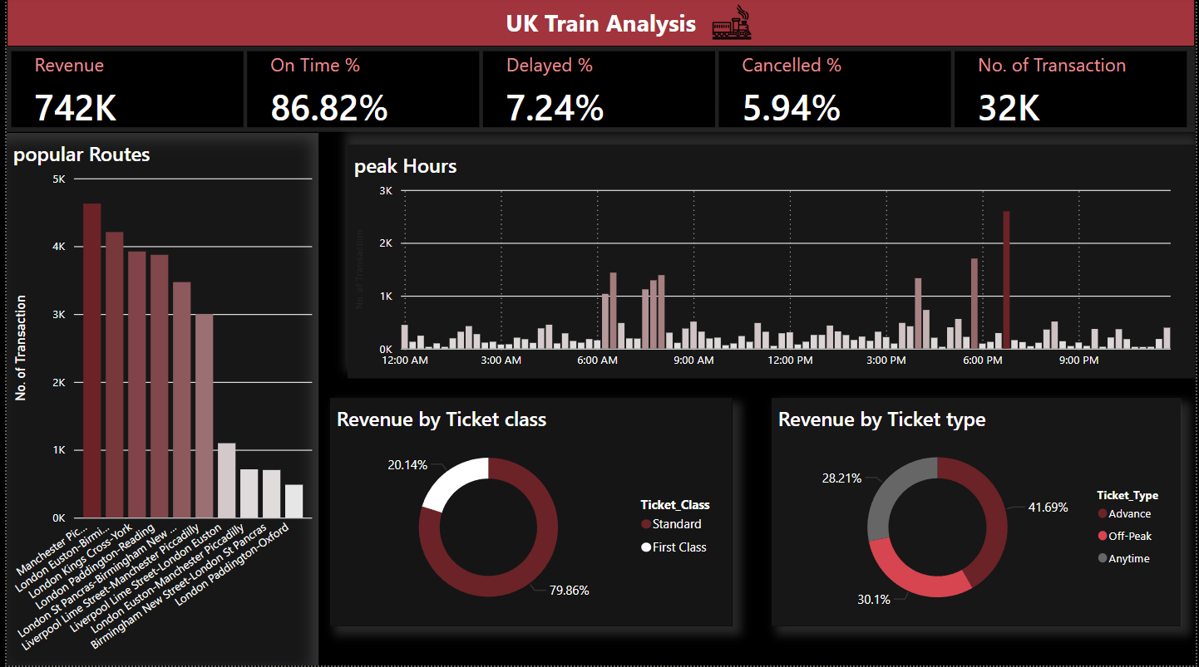
Data Visualization

Slide 14
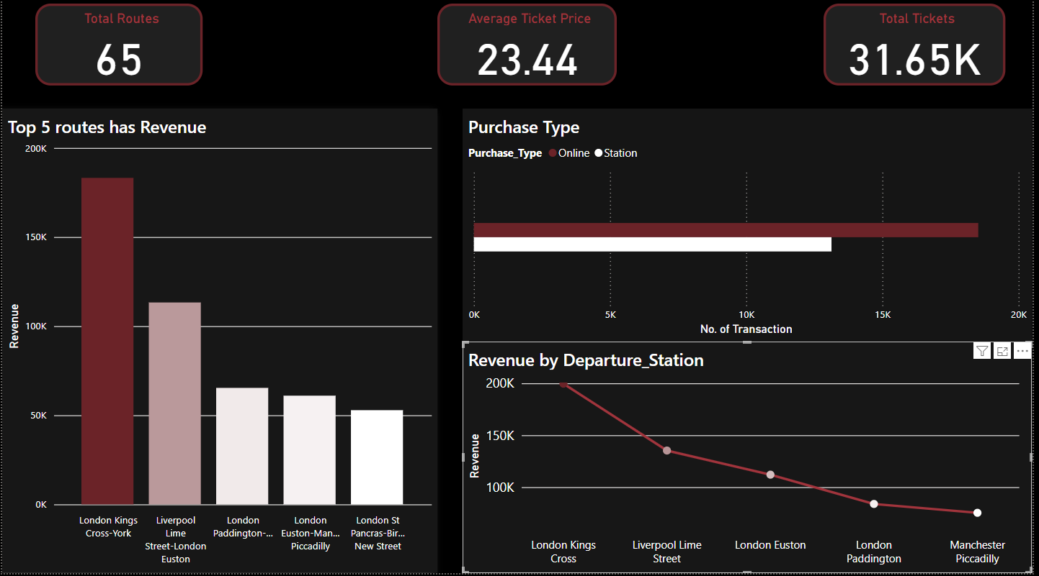

Slide 15
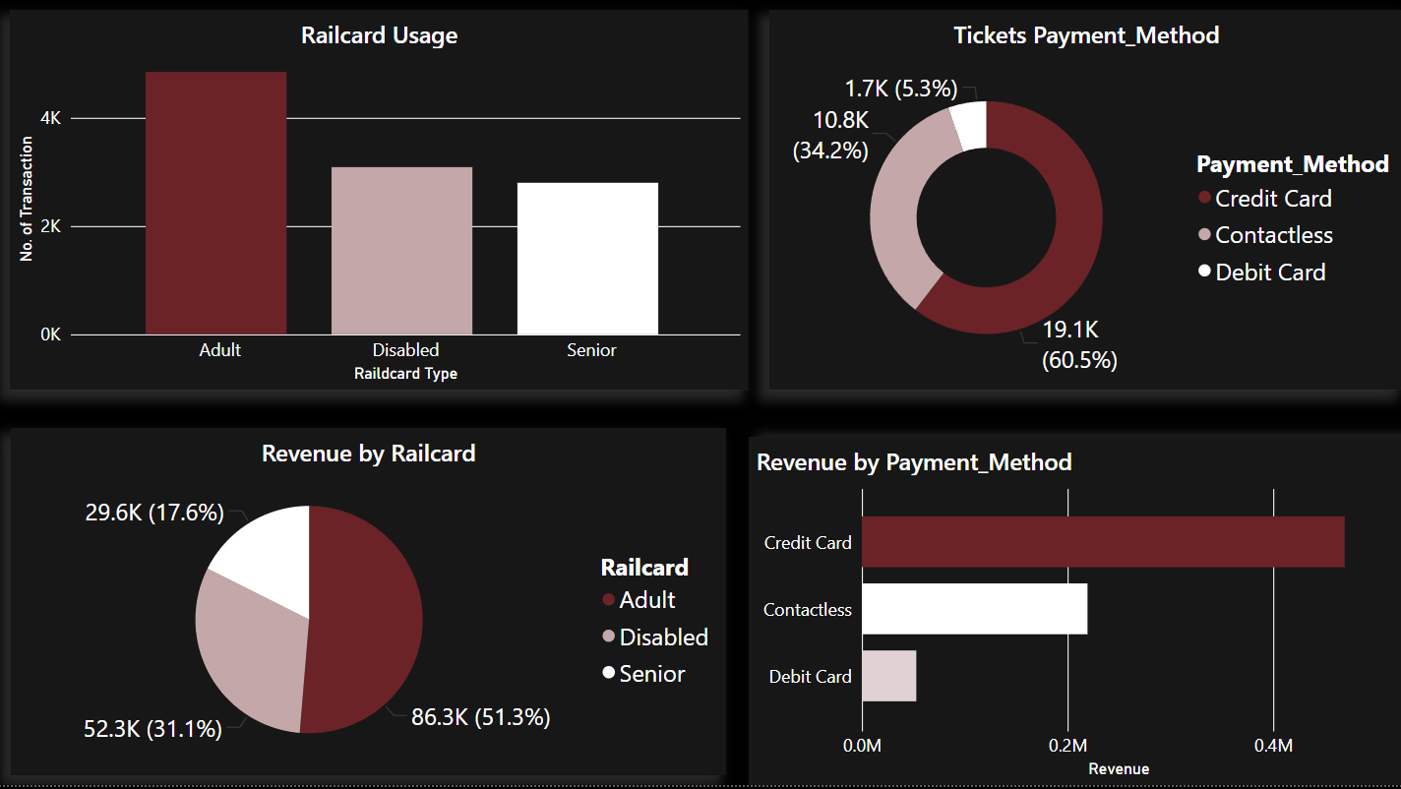

Slide 16
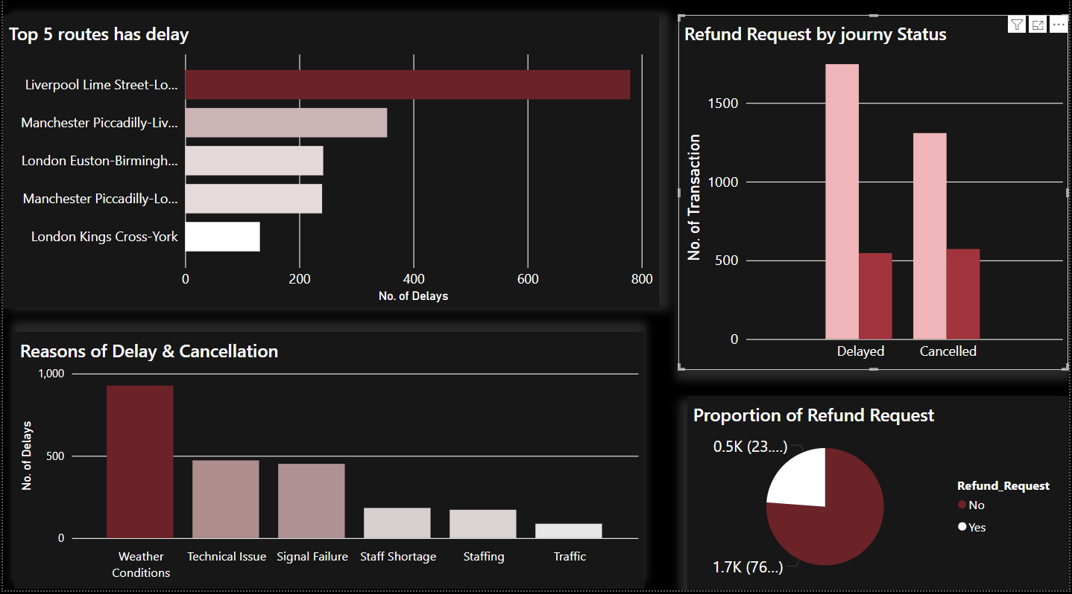

Slide 17
Recommendations:
Encourage More Advance Bookings The Advance ticket option offers savings but requires early planning. Increase awareness through reminders, push notifications, or email campaigns to encourage customers to book earlier and reduce last-minute peak-time pressure.
Improve Real-Time Delay Management Although most delays are minor, real-time updates through apps or displays can increase customer satisfaction. Implement predictive alerts and more transparent communication on causes of delay.
Optimize Peak-Time Capacity Since off-peak tickets are more popular, consider offering incentives for off-peak travel to reduce congestion during peak hours. This could also include flexible working hour partnerships with businesses.
Enhance Refund Handling Process Ensure refund requests—especially for delays exceeding 30 minutes—are processed quickly and transparently. Automating refunds for eligible trips can improve trust and reduce complaints.
Re-evaluate First-Class Pricing or Benefits With low usage of first-class tickets, consider either reducing pricing, bundling perks, or repositioning first-class for business travelers to improve uptake.

Slide 18

Please Listen to the Final Project Conclusion

Slide 19
THANK YOU!

